Slide 1
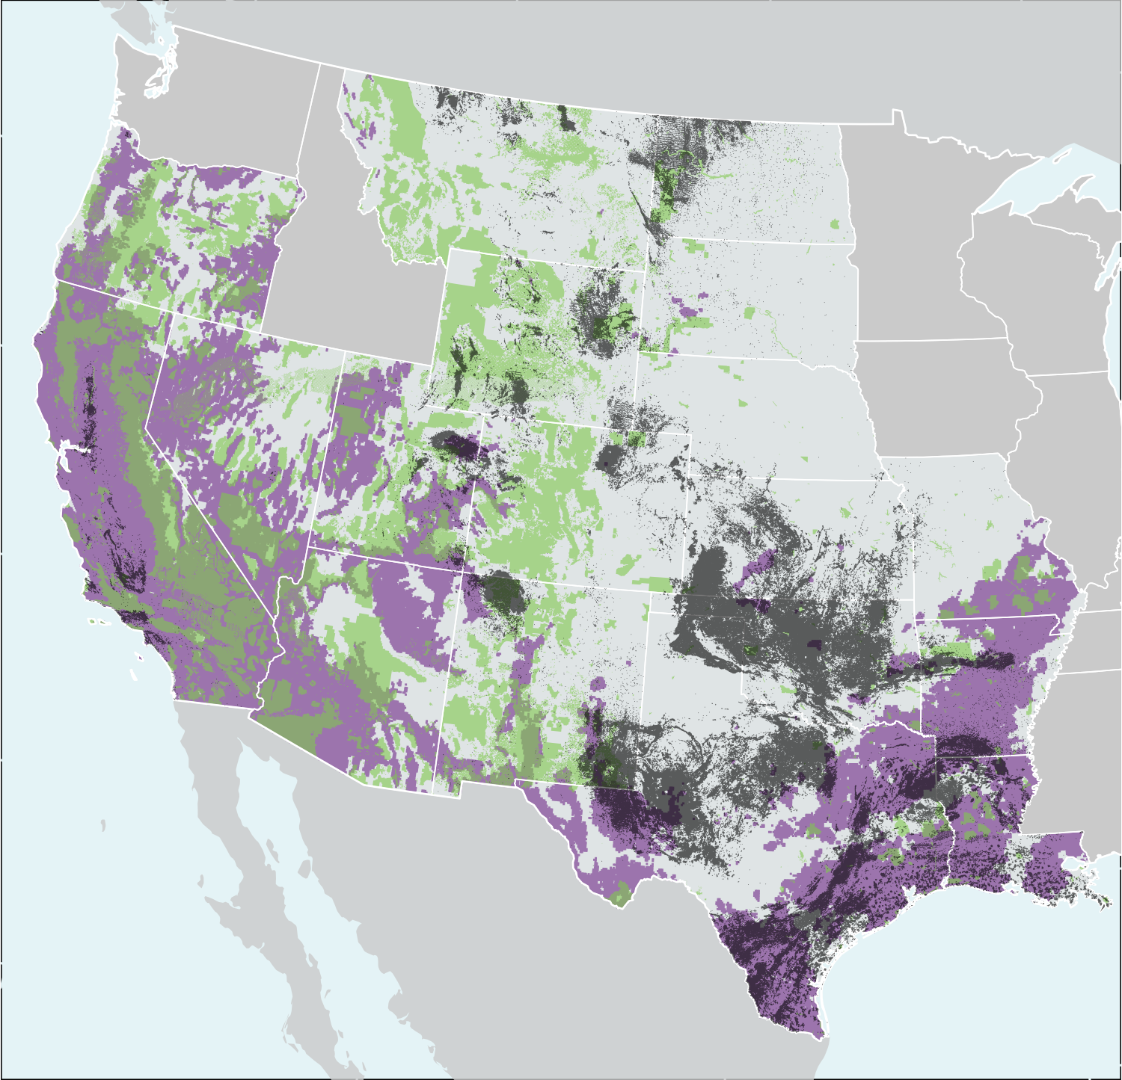
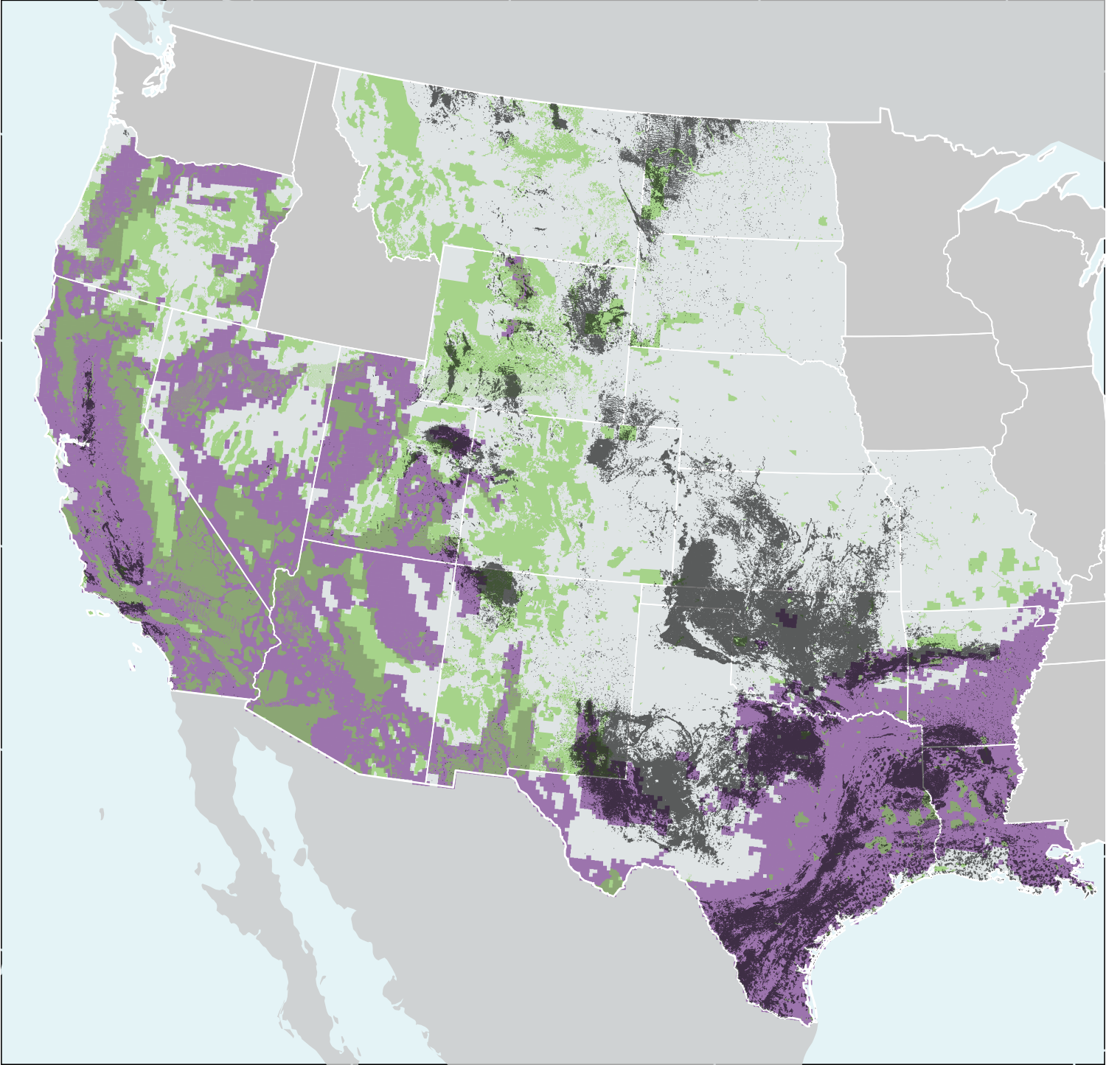
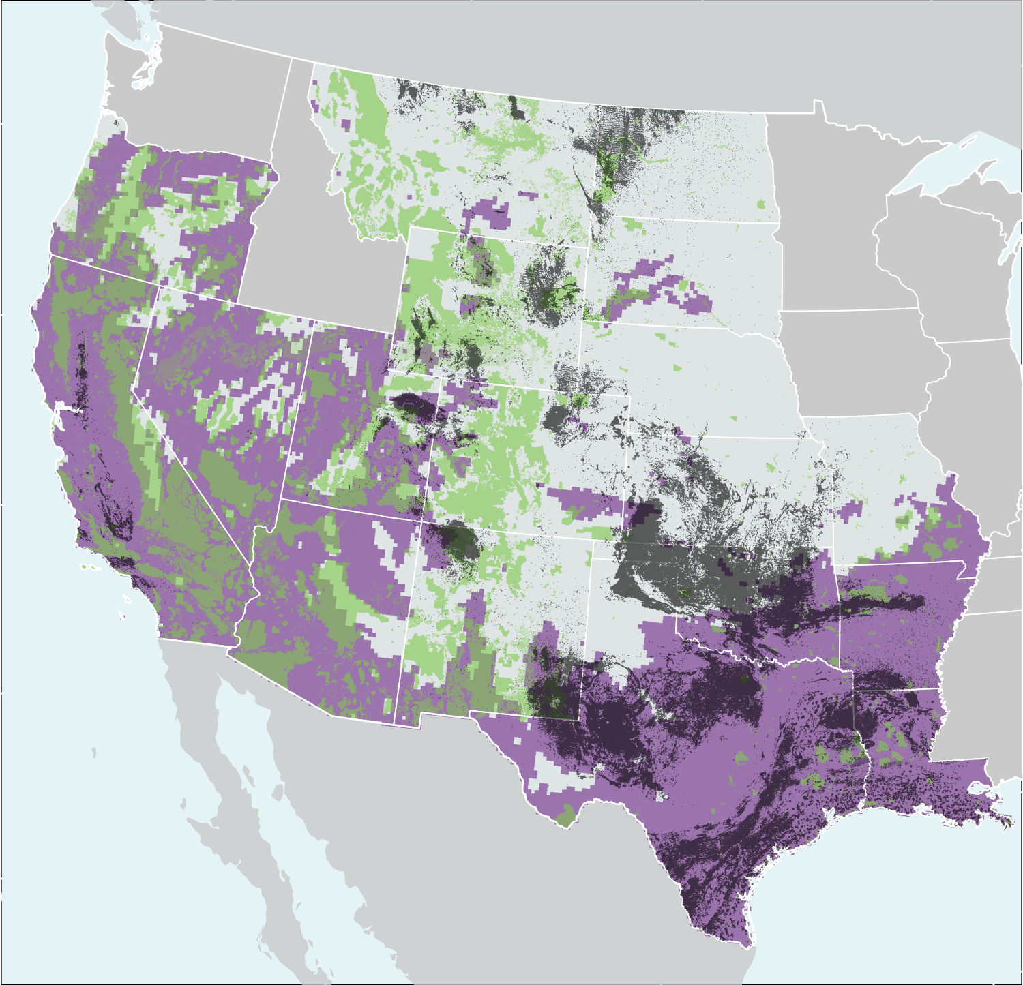
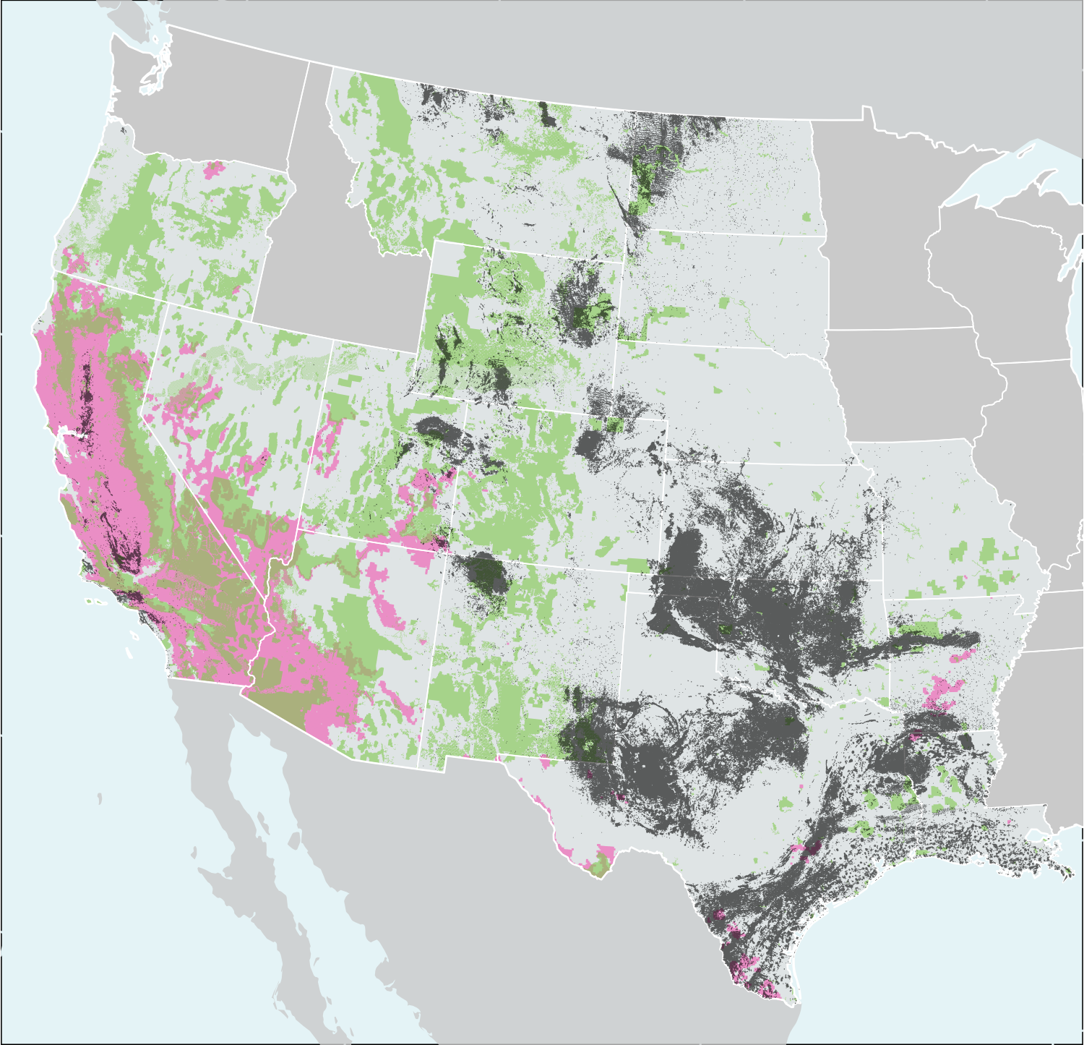
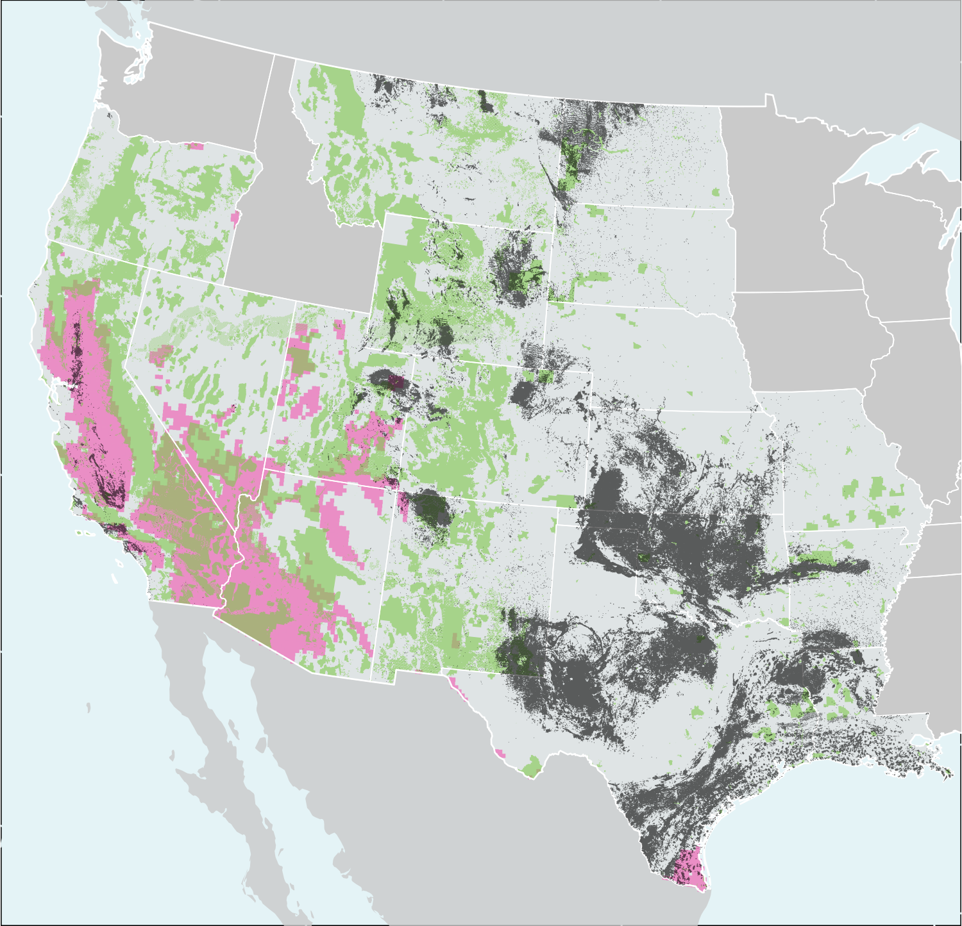
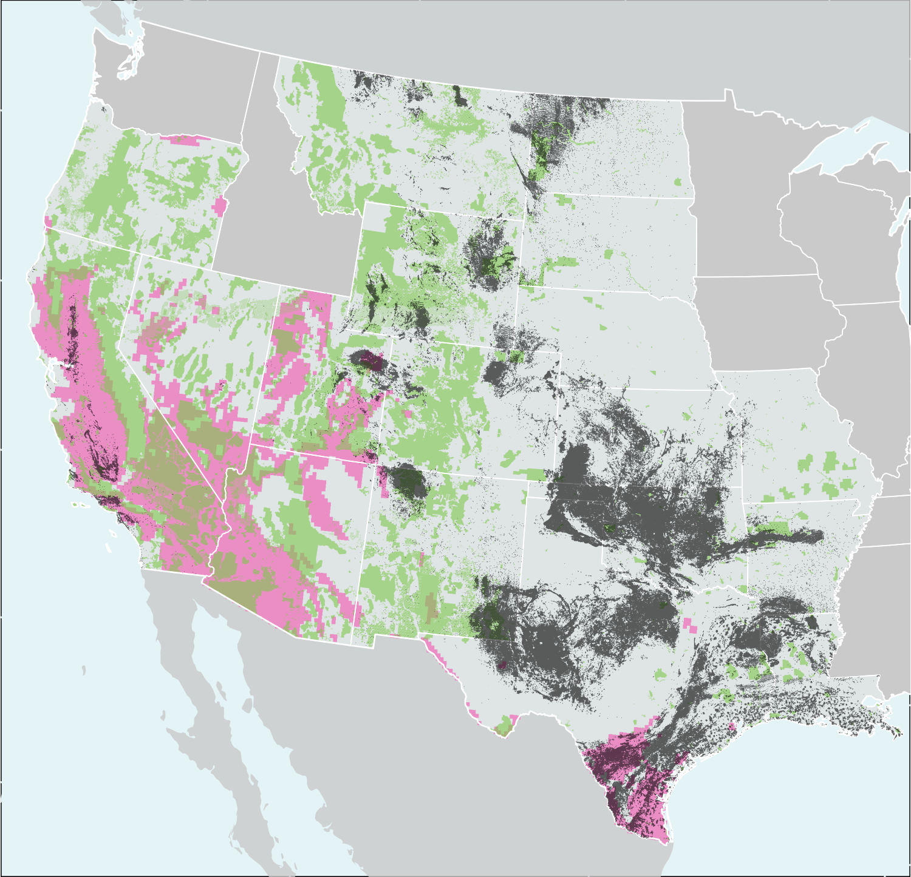
Historical (1996–2004)
Mid-century (2046–2054)
Late century (2086–2094)
A
B
C
Moderately high risk (KBDI ≥ 450)
D
E
F
High risk (KBDI ≥ 600)
Federal land
Moderately high risk areas
High risk areas
1 km buffer around all existing oil and gas wells

